Slide 1
Industries Perspective on Licensing
By Melissa Kracht

Slide 2
Maintaining Licenses in Multiple States

Slide 3
Maintaining Licenses in Multiple States

Slide 4
Challenges
Different requirements
Multiple filings for each state
States have become stricter
Multiple trust accounts needed
Response times
Time consuming

Slide 5
Overcoming Challenges
Utilize Registered Agents’ website & email reminders
In-house excel tracker
Individual state license folders
Centralized email inbox
Monthly licensing meetings
Cross training

Slide 6
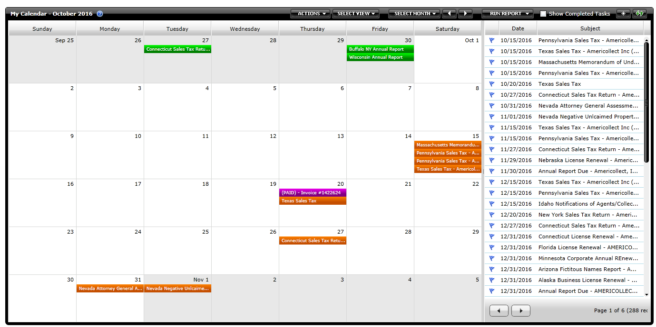
Overcoming Challenges
Notes:
Utilize our Registered Agents website to track all license renewals/reports via a calendar

Slide 7
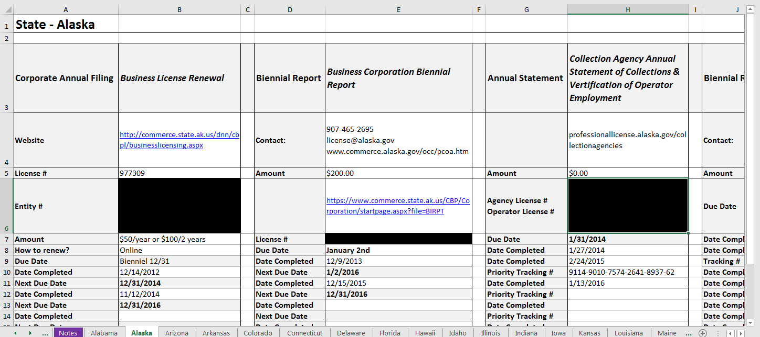
Overcoming Challenges

Slide 8
Overcoming Challenges
NMLS

Slide 9
NMLS – If Only!
Systematic way to file annual reports and other agency renewals

