Slide 1
21st Century Debt Collection in a 20th Century Regulatory Framework
David D. Cherner, Esq.
Moss & Barnett
Tim Bauer, Co-Executive Director
Consumer Relations Consortium
October 2017

Slide 2
About CRC
30+ of largest ARM firms
All CFPB large market participants
Collaborate with regulatory agencies
Proactively engage with consumer groups
Collecting the right debt, from the right consumer, the right way

Slide 3
Collaboration with Consumer Action

Slide 4
Biggest Change in Last 25 Years
at

Slide 5
Communication Today

Slide 6
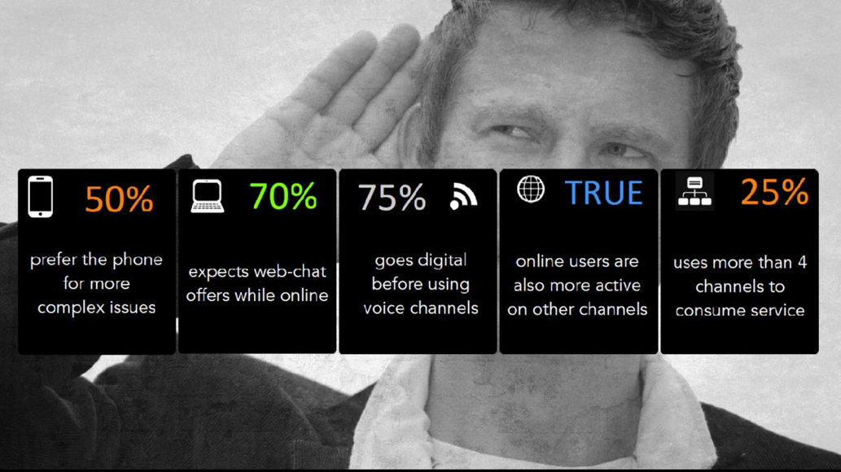
How We Communicate

Slide 7
A Typical ARM Scenario
Creditor
Collector
Consumer Chooses to Communicate Electronically
Manages Account Electronically
Electronic Internal Collections
Mail
&
Phone Calls

Slide 8
Communication Shifts in ARM
Increasing demand by consumers
Example - FTC ID theft affidavit
Creditor/consumer expectations for omni-channel opportunities
Creditors sending e-mail and cellular phone data
Mailing and labor costs dynamics
Web site vs. the call center as the consumer communication hub

Slide 9
Challenges to Communicating with Consumers
Exponential Move from landlines to cell phones
Telephone Consumer Protection Act
FCC Definition of ATDS (Automatic Telephone Dialing System)
Scams have made consumers nervous
The “dance” when trying to authenticate
“Robocall” Blocking initiative
Potential debt collection rules limiting contact attempts

Slide 10
Supporting Consumer Choice
Consent management
Applying call and mail analytics to omni-channel
Related security, privacy, and oversight
Managing changing landscape around ARM

Slide 11
Legal Framework & Challenges
Blurring line between first-party, early-out, third-party
Change in technology use and CRM development
Potential unintended shifts in policy
Definition of a communication
Application of contact restrictions
Incorporation of templates into omni-channel
Record retention requirements
Storage implications
Remote data management

Slide 12
Thank You
www.crconsortium.org

