Slide 1

NMLS 2.0 Update
North American Collection Agency Regulatory Association
(NACARA)
October 3, 2017

Slide 2
Outline
What is NMLS?
Debt Collection Regulators on NMLS
NMLS 2.0 Development Overview

Slide 3
What is NMLS?
Nationwide Multistate Licensing System
Owned by state regulators
  Used by 62 state agencies & 5 federal agencies
System of Supervision
  Collaborative supervision
  Currently licensing
  Soon to be investigations & examinations

Slide 4
Debt Collectors on NMLS

Slide 5
Debt Collection Licensing on NMLS
  8 State Agencies
  1,189 debt collectors
  3,657 licenses

Slide 6
Debt Collection Licensing on NMLS
State Agency | License Description | Approved Licenses
AZ | Collection Agency License | 328
CT | Consumer Collection Agency License | 630
ID | Collection Agency License | 358
IN-SOS | Collection Agency License | 743
MA | Debt Collector | 412
ND | Collection Agency License | 535
OR | Collection Agency Registration | 142
RI | Debt Collector Registration | 503

Slide 7
Debt Collection Licensing on NMLS

Slide 8
Debt Collection Licensing on NMLS
Debt collectors by number of states with reported activity
as of June 30, 2017

Slide 9
NMLS 2.0 Development Overview

Slide 10
NMLS 2.0
Opportunity not to just improve the system, but to rethink the system.
Notes:
At AARMR 2016, we started with this idea.
I told you how 93% of MLO applications were approved in 2013 (6% withdrawan)
Asked you to start with the end in mind.
Why do we license?

Slide 11
Licensing in the Digital Age
Greater information than ever before about companies and individuals
  Agencies no longer need to work in silos
Pressures to move from permission-based to accountability-based
  “Travel Network Companies” (TNCs)
  Push back on professional licensing
Speed and complexity of changes increasing
  e.g. Payment systems
  Access to data will precede knowing what to do with it

Slide 12
Supervision 2.0
Put regulators in control of the platform.
Access to more real-time data lessens the # of permission decisions that regulators have to make
Adopt and adapt
  Adopt the techniques of digital oversight
  Adapt to a risk-based focus

Slide 13
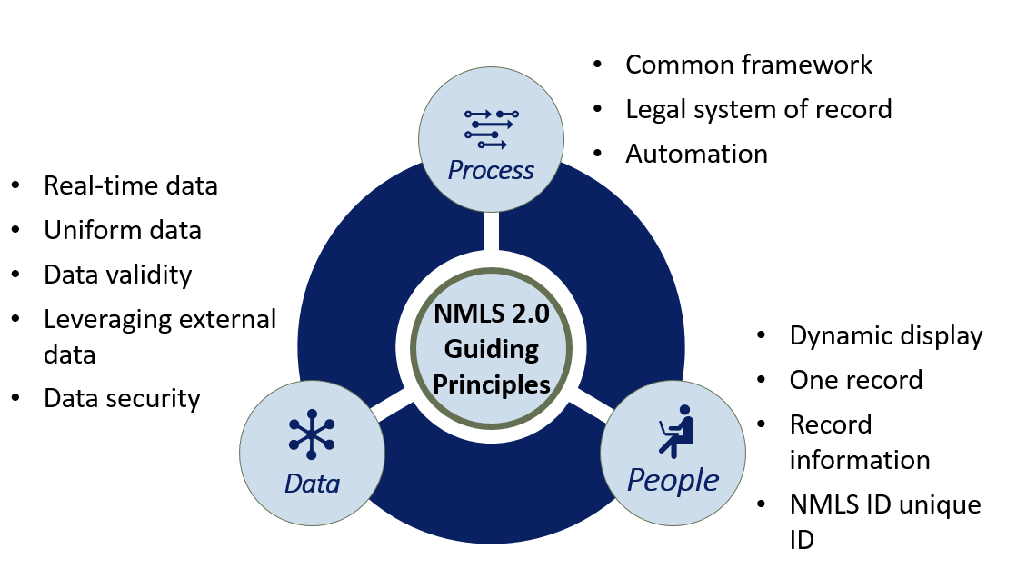
Guiding Principles

Slide 14
NMLS 2.0 Objectives:
Be User Driven: Intuitive, built with industry and regulatory users in mind.
Be Responsive: Display relevant information, actionable items based on user role.
Accurate Data: Leverage data analytics wherever possible to credential, validate and ensure the accuracy of information in the system.
Expedite Processing: Automate the identification of compliant candidates
Secure Data: Adopt industry best practices in data security

Slide 15
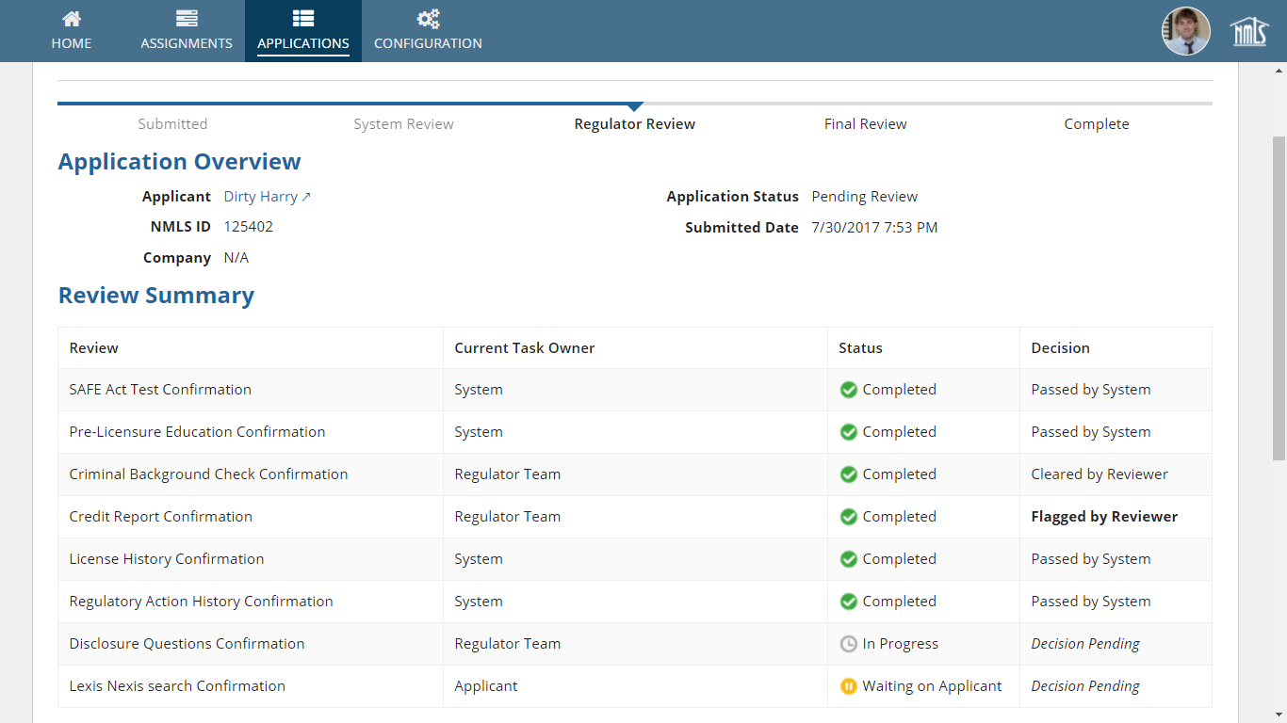

Slide 16
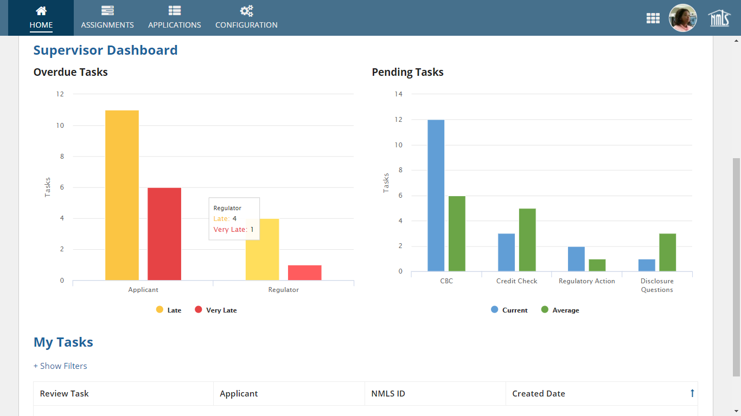

Slide 17
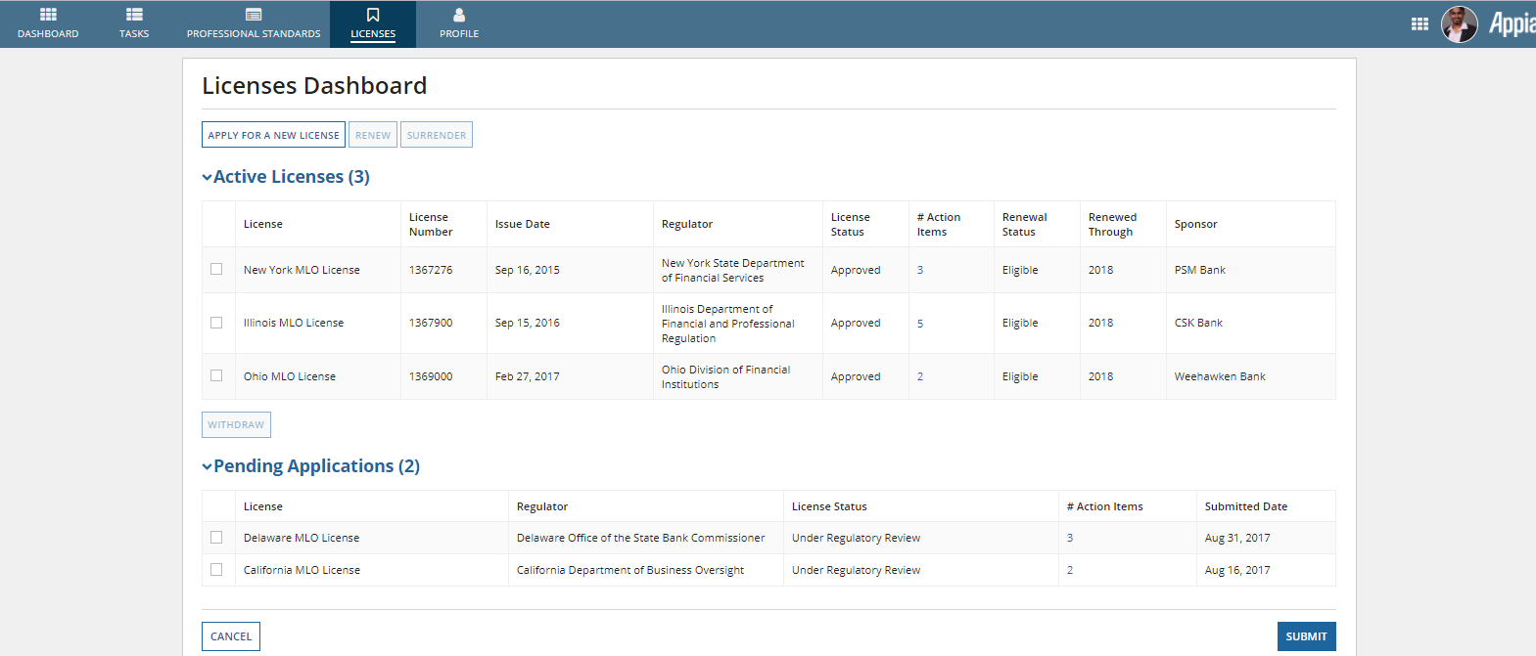

Slide 18
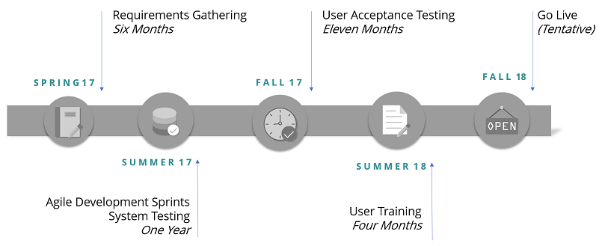
Development Timeline

Slide 19
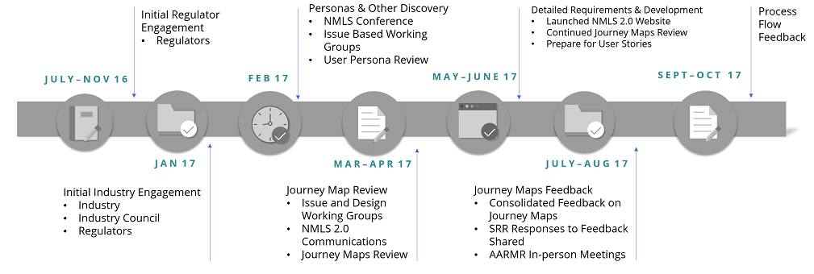
Engagement to Date

Slide 20
Next Steps: Prototyping
Module | Major Change from 1.0 | Heavy UX Work
Information Architecture Individual: Tasks, Profile, Licenses, Professional Standards Company: Tasks, Profile, My employees, My Licenses Regulator: Tasks, Profile, Reports, Research |  | ✓
Business Activities | ✓ | ✓
Regulator Review of New License Application + Communications Log | ✓ | ✓
Individual licensee application submission (state) | ✓ | ✓
Regulator Workload/Task Management (Reviewer and Supervisor views) | ✓ | ✓
Individual Registration (federal) | ✓ | ✓
Change in Control Amendments | ✓ | ✓
Employment Lifecycle | ✓ | ✓
Eight major functionalities will be demoed over the next 3 months for Regulator feedback

Slide 21
Questions? Ideas?
Tim Doyle (tdoyle@csbs.org) 202-728-5728

