Slide 1
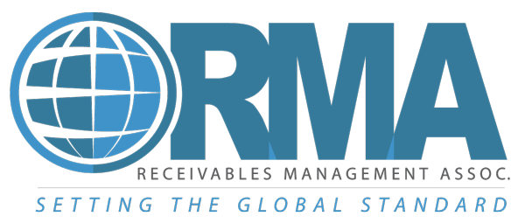
Debt collection industry overview
Andy Madden, ACA International
Stephanie Eidelman, Consumer Relations Consortium & insideARM
David Reid, Receivables Management Association

Slide 2
Agenda
Economic impact of collection industry
Legislative trends and highlights
Mass Disputes / Credit repair companies
Call blocking & labeling
The state of communications with consumers
Certification

Slide 3
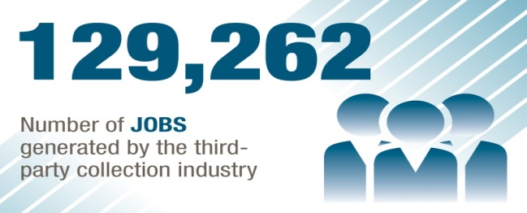
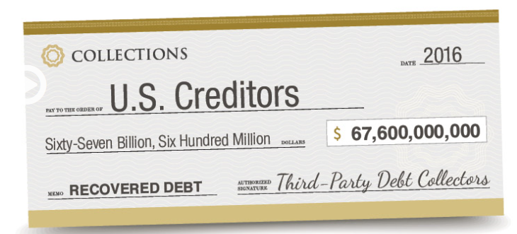
New Economic Impact Survey
Notes:
The Ernst & Young Economic Impact survey is our leading advocacy tool at both the state and federal levels.
The data is appreciated by regulators and legislators.
The one page state summaries have already been used by multiple units in their lobbying efforts this year (OR, IN, FL, MD, DC, Mass, RI, IL…). These summaries are located on our website. Check out the E&Y link on our homepage.

Slide 4
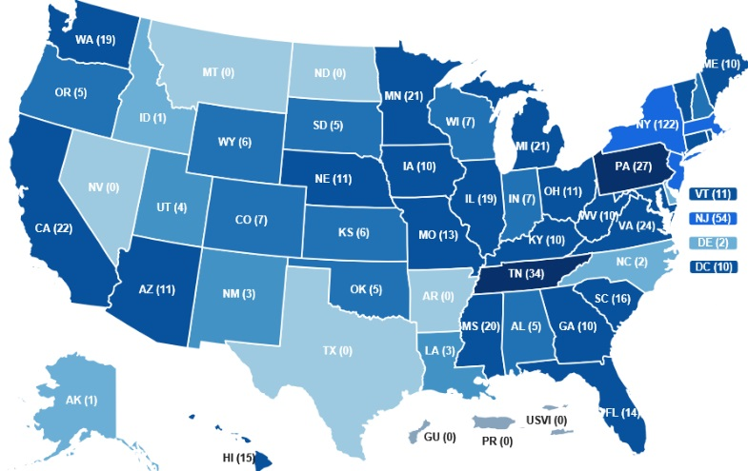
Legislative Trends and Highlights
Increase in garnishment exemptions
Shortening the Statute of Limitations
Increase/decrease use of Private Collection Agencies
Call blocking and labeling
Reigning in mass generic dispute letters
Notes:
In handing down its hotly-anticipated decision in the pivotal ACA Int’l case, ruling 3-0 in favor of business industries, the D.C. Circuit Court focused on the key issues ACA presented in its challenge to the 2015 Telephone Consumer Protection Act (TCPA) Declaratory Ruling and Order, including the definition of an auto-dialer, a reasonable manner approach to revocation of consent, and the one-call exemption for reassigned numbers. The appellate court’s opinion set aside the FCC’s explanation of which devices qualify as an Automated Telephone Dialing System (ATDS), as well as its understanding of when a caller violates the act by calling a wireless number previously held by a consenting party but reassigned to a person who has not given consent.
The appellate court, however, sustained the commission’s ruling that a party can revoke consent through any reasonable means by clearly expressing a desire to receive no further calls or texts.

Slide 5
ACA International v. FCC
The D.C. Circuit Court of Appeals:
Set aside the FCC’s expansive interpretation of what equipment constitutes an ATDS.
Invalidated the FCC’s rule with respect to reassigned numbers.
Upheld the FCC’s rule on consent revocation.
What’s next?
Notes:
In handing down its hotly-anticipated decision in the pivotal ACA Int’l case, ruling 3-0 in favor of business industries, the D.C. Circuit Court focused on the key issues ACA presented in its challenge to the 2015 Telephone Consumer Protection Act (TCPA) Declaratory Ruling and Order, including the definition of an auto-dialer, a reasonable manner approach to revocation of consent, and the one-call exemption for reassigned numbers. The appellate court’s opinion set aside the FCC’s explanation of which devices qualify as an Automated Telephone Dialing System (ATDS), as well as its understanding of when a caller violates the act by calling a wireless number previously held by a consenting party but reassigned to a person who has not given consent.
The appellate court, however, sustained the commission’s ruling that a party can revoke consent through any reasonable means by clearly expressing a desire to receive no further calls or texts.

Slide 6
Mass Generic Dispute Letters
The primary tool used by credit repair organizations is sending generic dispute letters in mass.
The generic dispute appears to be sent from the consumer.
Letters arrive in recognizable batches - same day, same postmark (despite debtors being geographically diverse), signatures in the same handwriting…
Disputes are not based on any actual dispute and lack any specificity that can actually be investigated.
The purpose is to overwhelm creditors who furnish data to the credit bureaus with the hope that they will delete valid trade lines from the consumer’s credit history.
The Solution: Make Truth in Disclosure mandatory on all notices generated by Credit Repair Organizations.
Notes:
In handing down its hotly-anticipated decision in the pivotal ACA Int’l case, ruling 3-0 in favor of business industries, the D.C. Circuit Court focused on the key issues ACA presented in its challenge to the 2015 Telephone Consumer Protection Act (TCPA) Declaratory Ruling and Order, including the definition of an auto-dialer, a reasonable manner approach to revocation of consent, and the one-call exemption for reassigned numbers. The appellate court’s opinion set aside the FCC’s explanation of which devices qualify as an Automated Telephone Dialing System (ATDS), as well as its understanding of when a caller violates the act by calling a wireless number previously held by a consenting party but reassigned to a person who has not given consent.
The appellate court, however, sustained the commission’s ruling that a party can revoke consent through any reasonable means by clearly expressing a desire to receive no further calls or texts.

Slide 7
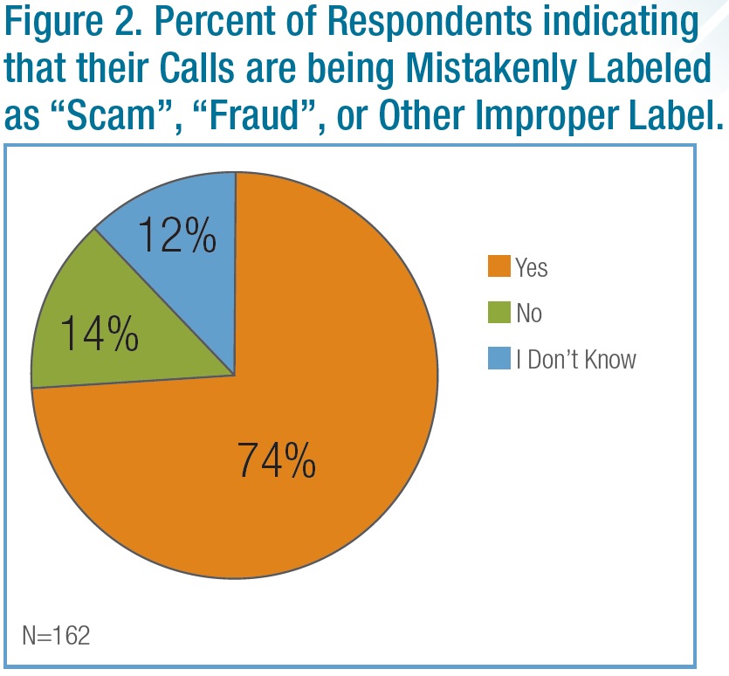
Call Blocking and Labeling
A report by First Orion predicts that nearly half of all calls made to mobile phones in the U.S. will be scams by next year.
The misclassification of legitimate business calls threaten the ability of collectors to communicate with consumers.
Hinders consumers’ ability to make informed decisions.
ACA members have seen their call contact ratio decline by 40% in recent years.
Notes:
The Ernst & Young Economic Impact survey is our leading advocacy tool at both the state and federal levels.
The data is appreciated by regulators and legislators.
The one page state summaries have already been used by multiple units in their lobbying efforts this year (OR, IN, FL, MD, DC, Mass, RI, IL…). These summaries are located on our website. Check out the E&Y link on our homepage.

Slide 8
Call Blocking & Labeling
“Robocalls” sounds pejorative, but is simply a term for calls made by an automated dialer.
Among legitimate firms, use of a dialer provides important compliance benefits.
Important to differentiate between legal and illegal robocalls.
Work is underway on a ‘Know Your Customer’ process to allow carriers and analytics organizations to establish who is a trusted caller.
Combined with STIR/SHAKEN, the ability to identify and register trusted callers should help to restore trust.
As for unwanted calls, consumers need enough info to make a choice, and they need to know what they are missing. But regs prevent this.

Slide 9
Communications Today

Slide 10
Communications in Debt Collection
Communication methods have changed, but the FDCPA has not …why?
in 1977
(and also today)

Slide 11
Transparent
3rd party disclosure

Slide 12
Communication & debt collection
A crisis of trust has emerged
Would you answer this call today?

Slide 13
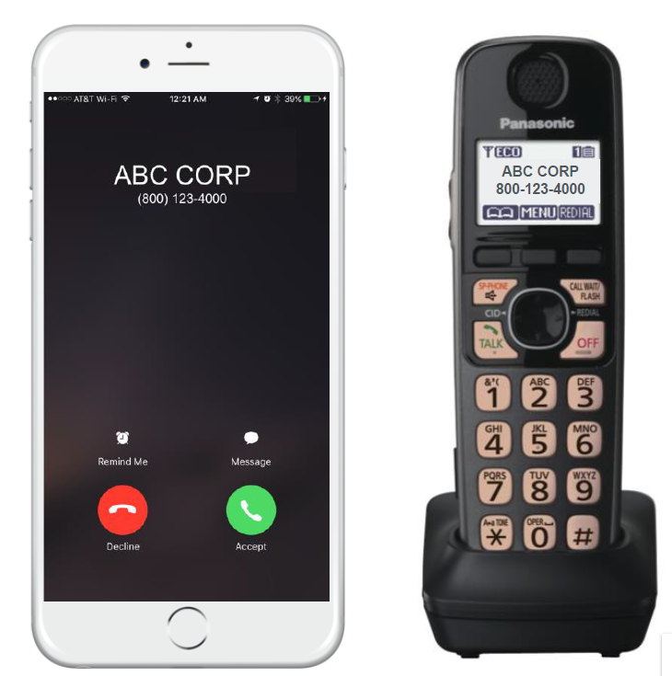
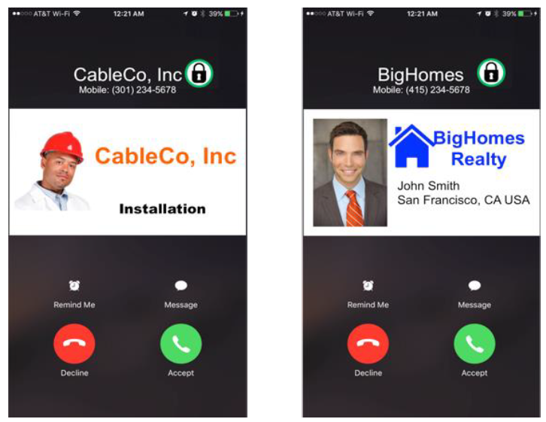
Here’s where the world is going

Slide 14
So, consumers are demanding to know this…
But debt collectors see this….

Slide 16
Communication & Debt Collection
If I do manage to reach a consumer on the phone, the broad and unclear definition of “communication” forces us to have an awkward and frightening “authentication dance.”

Slide 17
Transparent
So, we are back to this.
3rd party disclosure

Slide 18
BCFP Complaints in Perspective
The six New England states had 1,273 debt collection related complaints in 2017 on the Bureau of Consumer Financial Protection consumer complaint portal. This = .009% of the region’s population, or 1 complaint for every 11,569 people.
When looking at consumers not satisfied by the collector’s response, the number dropped from 1,273 to 60, which = .0004%, or 1 complaint for every 245,460 people.
That being said, industry recognizes that not everyone who has an issue will file a complaint. The industry takes all complaints seriously. They make us look bad. They make our clients look bad. We have every incentive to work with all stakeholders to reduce them.

Slide 19
RMA Certification
“I am appreciative of the benefits that the public gets from RMA’s industry self regulation, the collection and debt buying industry get from it, as well as we (government agencies) get from it.” (8/1/18)
–Thomas Pahl, BCFP Associate Director of Research, Markets & Regulations

Slide 20
RMA Certification – Certified Professional Receivables Company (CPRC)
Launched in 2013
Raised the bar on consumer protection
Supported by the BCFP & FTC
Voluntary Industry Self Regulatory Program for Businesses
Collection Agencies
Debt Buying Companies
Law Firms
Receivable Brokers
Single Compliance Footprint
Independent Third Party Audits
Annual Program Review
Version 7.0 in Development

Slide 21
RMA Certification – Standards
35 Standards, including:
Criminal Background Checks
Employee Training Programs
Handling of Consumer & Regulatory Complaints
Data Security
Statute of Limitations
Vendor Management
Commissions
Meaningful Attorney Involvement

Slide 22
RMA Certification – Data & Documents
Data & documents broken down by asset class (Standard # 19)
Auto Deficiencies (14 required/4 commercially reasonable efforts)
Auto Secured (13/4)
Bankruptcy* (11/6)
Credit Cards (14/8)
Judgments (6/12)
Medical* (21/16)
Student Loans* (in development)
* Being added in Version 7.0

Slide 23
RMA Certification – BCFP Statistics

Slide 24
RMA Certification – Large Participant Complaint Volume Based on Portfolio Size

Slide 25
RMA Certification – Litigation Statistics
On average, after certification, RMA certified companies experience a 6.53% decrease in litigation

Slide 26
How State Regulators Can Help Improve the Industry & Help Consumers
See industry participants as your allies – find ways to work together
Enforce existing laws
When adopting new requirements – seek uniformity in standards, or alternatively, consider reciprocity
Do not be afraid of modern technology… consumers aren’t

Slide 27
Please, contact us
Andrew Madden Director, State Government Affairs ACA International madden@acainternational.org
David Reid Director of Government Affairs & Policy RMA International dreid@rmaassociation.org
Stephanie Eidelman Executive Director, Consumer Relations Consortium CEO, The iA Institute & insideARM stephanie@theiainstitute.com

