Slide 1
Preemption & State Student Loan Servicing Regulation
Chuck Cross, CSBS
September 2019
For Discussion Purposes Only
Notes:
Melinda Lee, CA DBO
Cindy Fazio, WA DFI
Brad Fletcher, IL DFPR
Mike Townsley credit

Slide 2
Federal Student Loan Programs
Through the Higher Education Act (HEA), Congress has created federal programs to help students finance post-secondary education, including:
Federal Direct Loan Program (FDLP)
Federal Family Education Loan Program (FFELP).
These programs are administered by the Department of Education (ED).
FDLP Loans
Originated by ED
ED contracts with servicers to collect payments and interface with borrowers
FFELP Loans
Originated by private lenders
FFELP Loans owned by ED: ED contracts with servicers
FFELP Loans not owned by ED: Private lender contracts with servicers
Program discontinued in 2010
For Discussion Purposes Only
Notes:
Federal Student Loan Programs has become a somewhat confusing environment. The basics that you need to know are that there were two programs: FDLP and the discontinued FFELP program.

Slide 3
Student Loan Market
At the end of 2018, total outstanding student loan balances reached an all-time high of $1.6 trillion, owed by approximately 45 million consumers.
FDLP loans and Government-Owned FFELP loans total more than $1.2 trillion.
Commercial FFELP loans are in wind down, now totals less than $200 billion.
Private student loans (originated by banks, credit unions, state-sponsored lenders, and other private entities) total approximately $120 billion.
Source: Federal Reserve; U.S. Department of Education
For Discussion Purposes Only

Slide 4
Federal Student Loan Servicing
Most federal student loan servicing is performed by third party servicers.
Dominated by just 3 companies, which administer more than 80% of total federal loan portfolio:
Nelnet – a publicly traded company that acquired non-profit Great Lakes in 2018
Pennsylvania Higher Education Assistance Agency
Navient
Small, state-affiliated, non-profit servicers service FDLP and/or FFELP loans.
Typical federal student loan servicer responsibilities:
Collecting payments on federally held student loan that are not in default status
Advising borrowers on available resources to better manage their loan obligations
Responding to borrowers’ inquiries,
Other administrative tasks
For Discussion Purposes Only
Notes:
Most servicing is performed by third parties.
3 dominate the market.
There are small servicers that are non-profit and typically affiliated with local government.
Responsibilities of servicers:

Slide 5
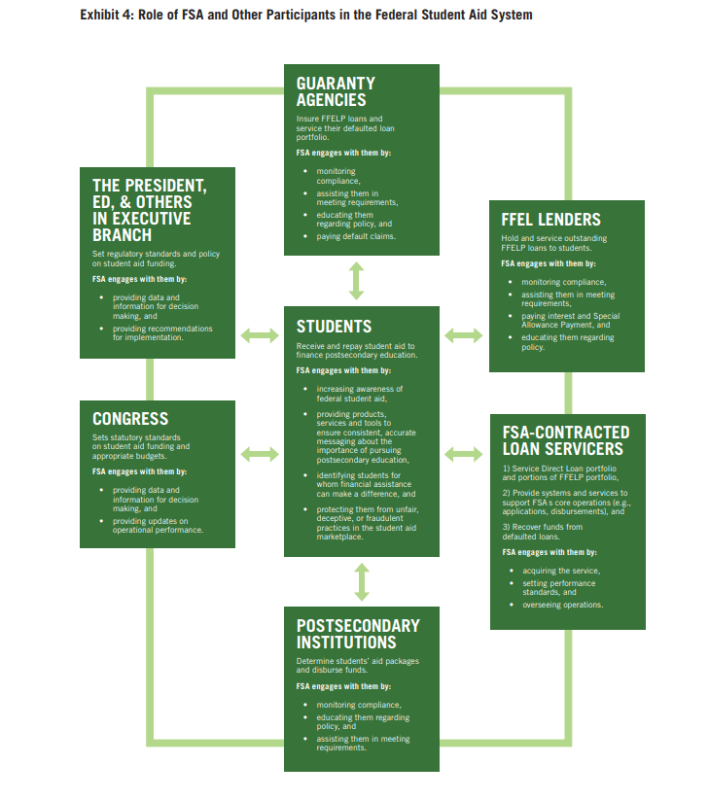
Federal Student Loan Servicing Oversight
Oversight mechanisms:
Call monitoring
Compliance reviews
Internal control audit reviews
Borrower satisfaction reviews
Enforcement mechanisms:
Contracting standards
Performance metrics/Loan allocation methodology
For Discussion Purposes Only
Notes:
This is FSA oversight of servicers of government owned loans (FFELP and FDLP). The ED and FSA no longer have oversight of FFEL lenders because the FFELP has been discontinued.
The ED and FSA do not have oversight of FDLP loan origination because the federal government is the loan originator.
Guaranty Agencies: State and nonprofit guaranty agencies receive federal funds to play the lead role in administering many aspects of the FFELP, such as providing assistance in preventing delinquent borrowers from going into default. They continue to serve in this role with respect to outstanding FFELP loans.
“monitoring compliance “ is mysteriously omitted from FSA-contracted loan servicers but included for every other type of institution.

Slide 6
Federal Student Loan Servicing Oversight (cont.)
Deficiencies in FSA oversight:
Loan allocation methodology misaligned
Contractual accountability provisions rarely used
Not tracking instances of noncompliance
No oversight of servicer-directed borrower complaints
Typical substandard servicing practices:
Not informing borrowers about all repayment options
Miscalculating payments under IDR plans
Repeatedly placing borrowers in forbearance
For Discussion Purposes Only
Notes:
Cover deficiencies first:
The loan allocation methodology is used by FSA to allocate new loan volume to servicers. It uses five performance measures but does not factor in compliance with federal rules. This means that routine noncompliance has no impact on the amount of loans allocated to a servicer. The five performance measures used are (1) customer service satisfaction, based on a survey of borrowers (worth 35 percent of servicer’s overall score); (2) percentage of borrowers in current repayment status, or less than 6 days delinquent (30 percent of score); (3) percentage of borrowers more than 90 but less than 271 days delinquent (15 percent of score); (4) percentage of borrowers more than 270 but less than 361 days delinquent (15 percent of score); and (5) FSA employee survey results (5 percent of score).
IDR = income driven repayment plans. Designed to make it easier for federal student loan borrowers to pay back loans if debt is high compared to your income.

Slide 7
State Regulation of Federal Student Loan Servicing
In light of the substandard servicing practices, beginning in 2015, several states began passing laws requiring student loan servicers to obtain licenses to service education loans to borrowers residing in their states.
These licensing laws impose servicing requirements and subject the servicers to state supervision and enforcement.
To date, seven states have passed student loan servicer licensing laws and 11 states have legislation pending.
Enacted: California, Colorado, Connecticut, DC, Illinois, New York, and Washington.
Pending: Arizona, Massachusetts, Minnesota, Missouri, Nevada, New Jersey, New Mexico, North Carolina, Oregon, South Carolina, and Virginia.
When these laws were first enacted, the question arose whether state regulation was preempted
For Discussion Purposes Only
Notes:
Following problems and significant complaints around student loan servicing, states began passing laws to protect consumers.
Seven states have passed laws and 11 have pending legislation.
State law typically gives the states to supervise and enforce and this triggered preemption challenges.

Slide 8
State Regulation of Federal Student Loan Servicing
January 2016
Inquiry from Maryland to ED
July 2016
“Mitchell Memo” published
April 2017
“Mitchell Memo” rescinded
July 2017
Servicers petition ED for Preemption Notice
March 2018
ED publishes Preemption Notice
SLSA sues DC Department of Insurance, Securities and Banking (DISB)
April 2018
Servicer sues CT Department of Banking (DOB)
May 2018
For Discussion Purposes Only

Slide 9
ED Preemption Notice
In March 2018, ED issued an interpretation asserting federal preemption of state regulation of entities servicing student loans through the FDLP and FFELP (Preemption Notice).
The Notice asserted every type of preemption (field, conflict, and express) prevented state licensing of and enforcement actions against federal student loan servicers.
Express preemption: State reporting requirements and State UDAP-type laws.
Field preemption: State licensing of FDLP Loan servicers
Direct conflict (i.e. impossibility) preemption and Indirect conflict (i.e. obstacle) preemption: State licensing of FFELP & FDLP Loan servicers
The DC District Court rejected all of these arguments except for the obstacle preemption argument as applied to the servicing of federally-held student loans.
For Discussion Purposes Only

Slide 10
Post-SLSA v. DC Developments
DC DISB and SLSA appealed the DC Court’s decision in December 2018, but both parties moved to voluntarily dismiss the case in February 2019.
Similar litigation is pending in Connecticut, but no decision has issued.
The CT litigation raises some issues not extensively litigated in DC (i.e. access to student borrower records under the Federal Privacy Act).
Some states are altering their regulatory approach in light of the holding in SLSA v. DC.
In April 2019, DC DISB issued a bulletin stating that licensees are only required to provide information on the licensee’s non-federally owned loans.
Colorado law would establish an “automatic licensing” structure for federally-held loans.
For Discussion Purposes Only

